Slide 1

Sauce & Spoon Tablet Rollout
Impact Report

Slide 2
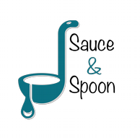
Executive Summary
This project was a pilot rollout to install tabletop menu tablets at the bar section of Sauce & Spoon North and Sauce & Spoon Downtown restaurants by the beginning of the second quarter (Q2). The project was launched with the vision of increasing customer satisfaction and retention by reducing delays in service and providing quality service which would subsequently help to increase the profit margin.
The project was a success in many ways. Customer satisfaction was high and we met our internal revenue goals. Just after the pilot, customer satisfaction was at 72%. Post implementation based on improvements based on feedback, customer satisfaction increased to 86%. Our monthly revenue has increased steadily since the tablet rollout, upwards of 20% since September/pre-rollout
Conducting a test run and analyzing the survey results helped immensely with identifying the tasks that needed a slight tweaking. Approaching with a positive and encouraging attitude and reminding that every one is working towards the same goals, helped with getting the staff to adapt to new approaches or changes.

Slide 3
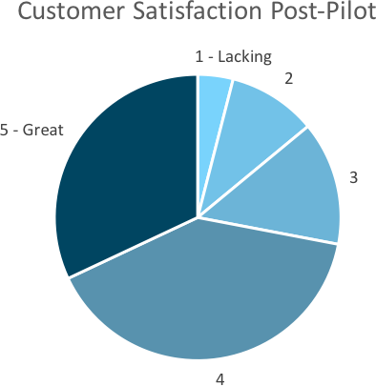
Customer Satisfaction: Pilot
Q. On a scale of 1-5, please rate your experience with the tablet overall.
This pie chart illustrates the results from the post-pilot survey.
72% of respondents indicated a customer satisfaction score of 4 or 5.

Slide 4
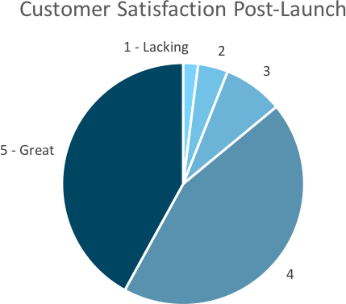
Customer Satisfaction: Launch
Q. On a scale of 1-5, please rate your experience with the tablet overall.
This pie chart illustrates the results from the post-launch survey.
86% of respondents indicated a customer satisfaction score of 4 or 5. This is a 19% increase.

Slide 5
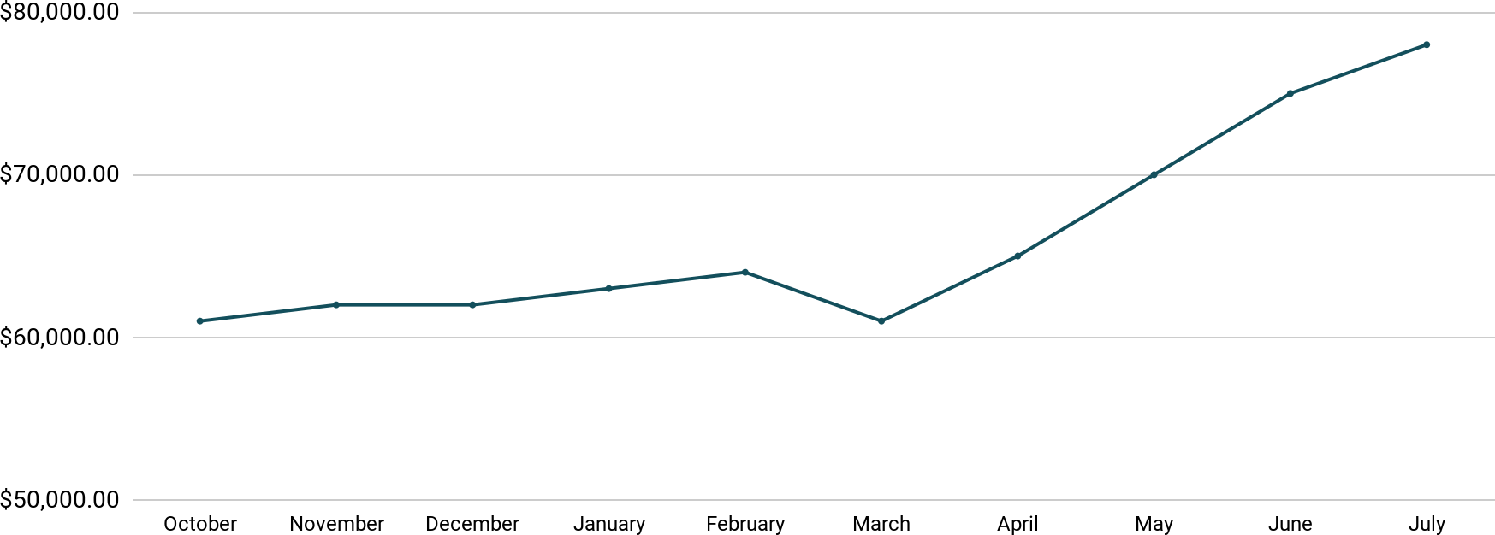

Revenue
Tablet Launch April 23
This is a chart of Sauce & Spoon revenue, showing that after tablet implementation, revenue increased.
July revenue was up to 20% over April’s monthly revenue.

Slide 6
What Worked: Key Accomplishments
Decreased table turn time
Increased customer satisfaction
●
Implementation of the tablets increased the average daily guest count by 10%.
Tablets also decreased wait time by 30 minutes.
●
After the pilot, customer satisfaction was at 72%.
Once we implemented improvements based on
feedback, customer satisfaction increased to 86%.
●
Decreased food waste
●
Tablets identified who was receiving an incorrect order.
Kitchen staff has taken the initiative to correct orders and decrease food waste by 50%.
Increased sales
●
Our monthly revenue has increased steadily since the tablet rollout, upwards of 20% since September/pre-rollout.
Tablets also helped boost revenue during the holiday season.
●

Slide 7
Lesson Learned
At the test, our guests seemed to have some trouble with the navigation, so we switched to a layout that guests have found much simpler.
At test we were behind on our objective of reducing table turn time, so we worked with the general managers on ways to speed things up. - training wait staff be more aware of guest pacing
●
Another change based on feedback was we implemented some better messaging around making sure guests know they’re paying with a card only. And I’m pretty sure we’ve weeded out the glitch tablets through a new pre- service checking system! We wanted fewer than 5% of customers reporting tech issues, and we got there.

Slide 8
Next Steps: Looking Forward
Initiative | Action | Date
Implement tablets in more locations | Create new project plan for new location installation | Q2
Continue to track customer experience and satisfaction | Continue surveying/ gathering data through various means | Ongoing
Expand tablet features | Investigate new features like social media integration, reservations, videos, etc. | Q4

Slide 9
Appendix
[link the project proposal]
[https://github.com/zoilosilang/Complete-Project-Charter.git]
[https://github.com/zoilosilang/Order-tasks-and-milestones.git]
[link the evaluation findings presentation]

